Slide 1
Maven market analysis
(Sales, Products, Returns & Customers | 1997–1998)

Slide 2
INTRODUCTION
Retail data analysis helps businesses understand sales performance, product success, customer behavior, and return impact.
Sales data is analyzed across products, stores, regions, and time periods.
The dataset includes transactions, returns, customers, products, stores, regions, and calendar information.
The analysis focuses on revenue trends, product profitability, return behavior, and customer insights.
Interactive dashboards highlight key performance metrics, problem areas, and opportunities for improvement.

Slide 3
OBJECTIVES
Evaluate overall sales, revenue, profit, and growth trends
Analyze product performance and profitability
Assess return behavior and revenue impact
Understand customer behavior and store performance

Slide 4
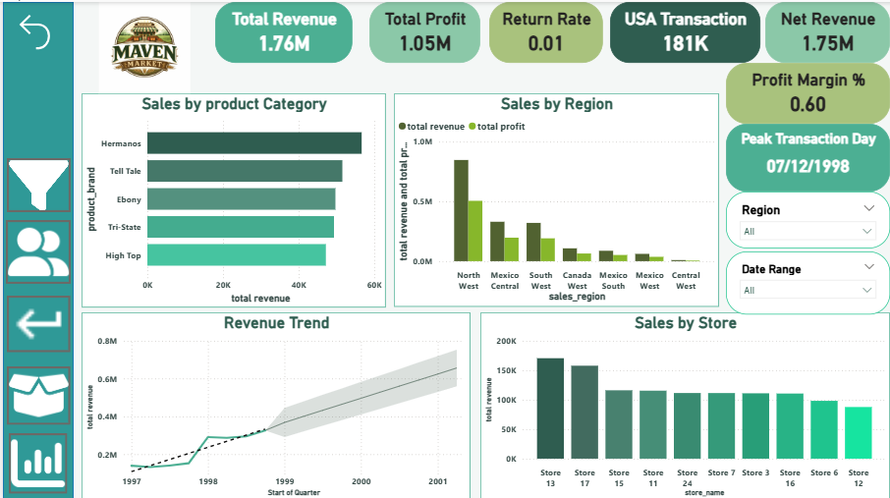
EXECUTIVE SALES OVERVIEW

Slide 5
EXECUTIVE DASHBOARD INSIGHT
Total revenue and profit indicate strong overall business performance with a healthy profit margin.
North West region is a major contributor to both revenue and profit.
Revenue shows a steady upward trend over time, indicating consistent growth.
A few stores contribute a large share of total sales, highlighting store concentration.
Return rate is low, minimizing overall revenue loss
Sales are concentrated in a few product categories and regions

Slide 6
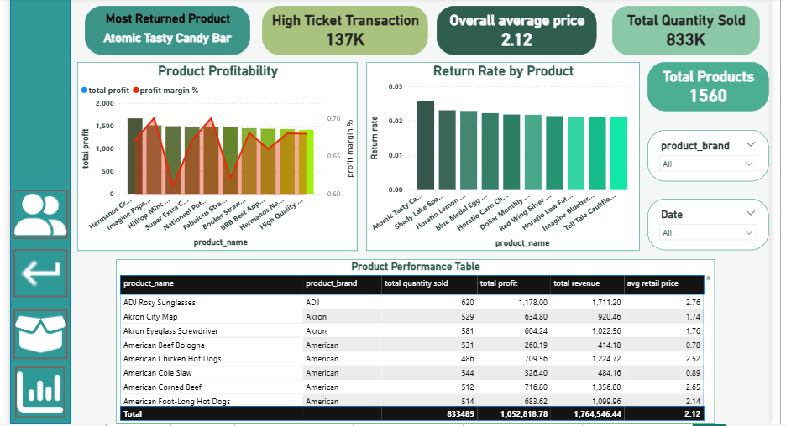
PRODUCT ANALYSIS DASHBOARD

Slide 7
PRODUCT ANALYSIS DASHBOARD INSIGHT
A small number of products generate significant revenue and profit.
High-ticket transactions contribute strongly to total profit.
Some products show high sales volume but lower profit margins.
Products with strong performance may still have higher return rates, indicating quality or expectation issues.
Product performance table helps identify top and underperforming products clearly.

Slide 8
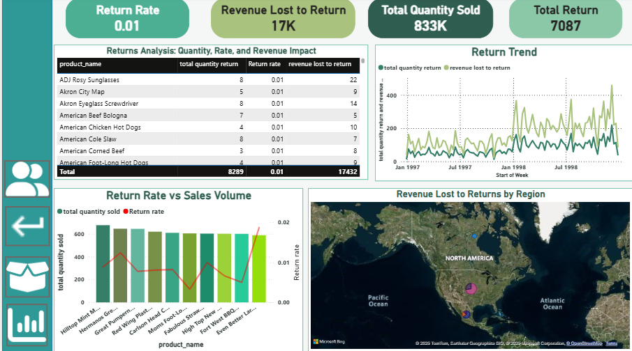
RETURN DASHBOARD

Slide 9
RETURN DASHBOARD INSIGHT
Overall return rate is low, but returns still cause noticeable revenue loss.
Certain products have higher return quantities compared to others.
Return quantities increase in line with sales growth
High-selling products often show higher return risk.
Specific regions contribute more to revenue lost due to returns.

Slide 10
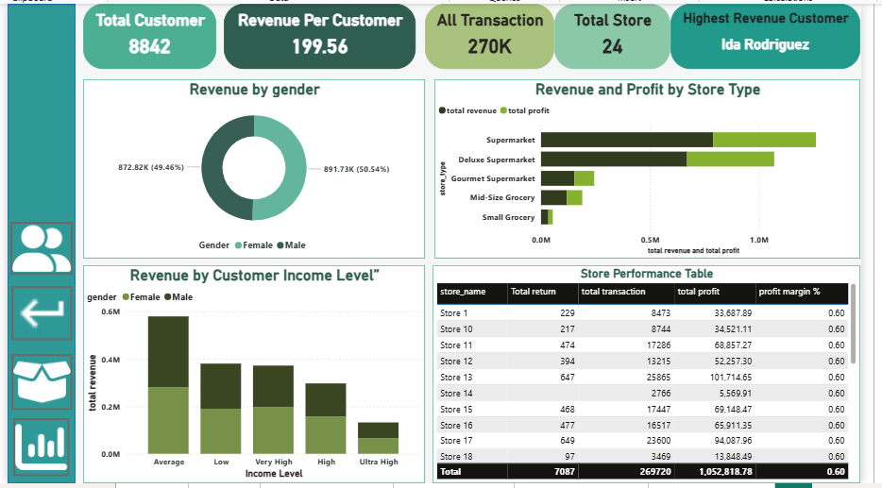
CUSTOMER AND STORE PERFORMANCE DASHBOARD

Slide 11
CUSTOMER AND STORE DASHBOARD INSIGHT
Average and low-income customers contribute most of the revenue.
Revenue contribution from male and female customers is nearly equal.
Supermarkets and deluxe supermarkets generate higher revenue and profit than smaller store types.
Revenue per customer shows strong customer value.
Store performance varies significantly across locations.

Slide 12
CARDS HIGHLIGHT
Total Revenue: 1.76M, showing strong overall sales performance.
Net Revenue: 1.75M after accounting for returns.
Total Profit: 1.05M, indicating healthy business profitability.
Profit Margin: 60%, reflecting efficient cost management.
Total Transactions: 270K completed transactions.
USA Transactions: 181K, contributing the largest share of sales.
Return Rate: 1%, low but financially impactful.
Revenue Lost to Returns: 17K due to returned products.
Total Customers: 8,842 active customers.
Revenue per Customer: 199.56, showing strong customer value.
Total Products: 1,560 products analyzed.
Total Quantity Sold: 833K units sold across all stores.

Slide 13
FINDINGS
Business Growth
Revenue Concentration
Returns Effect
Customer Behavior
Regional Influence
High-Value Sales

Slide 14
RECOMMENDATION
Focus on Top Products
Target Key Customers
Optimize Store Operations
Reduce Returns
Regional Strategy
Manage High-Ticket Risk

Slide 15
CONCLUSION
Maven Market’s analysis reveals a strong and profitable retail business with consistent revenue growth and a healthy profit margin. Sales performance is driven by a small set of high-performing products, stores, and regions, while customer income level plays a significant role in purchasing behavior and overall revenue contribution. Although the return rate remains low, returns still result in noticeable revenue loss, indicating the need for improved return management. Store and regional performance varies widely, highlighting opportunities for targeted strategies to improve underperforming locations. Overall, the insights support data-driven decision-making to enhance profitability, customer value, and operational efficiency.

Slide 16
Thank YOU

